Slide 1

Crowdfunding Analytics: Insights, Outcomes & Opportunities
A data-driven overview of Kickstarter’s trends, outcomes, and success factors.

Slide 2
Presentation Agenda
📊 Data Overview
🎯 Objectives: KPIs
⚙️ Process
🔎 Analysis
💡 Recommendations and Insights
🚧 Challenges & Learnings
📝 Conclusion
🖼️ Picture Dashboard/Report

Slide 3

Crowdfunding : Data Overview
This overview analyzes the scale, performance, and financial impact of the crowdfunding platform, providing insight into its growth, competitiveness, and potential value for creators and backers.
365.89K Projects Launched: A highly active platform with massive campaign volume.
38.35% Success Rate: Success is possible but requires smart, competitive execution.
39.97M Backers: A huge global community fueling creator projects.
80.36 Days to Succeed: Most winning campaigns reach goals in about 80 days.
$3.46B Raised: A powerful platform driving major funding opportunities.

Slide 4
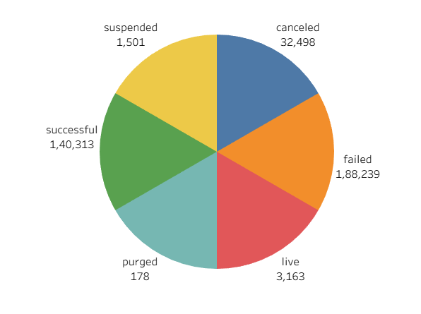
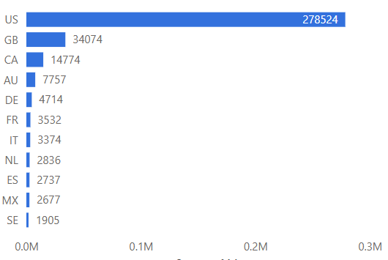
Objectives : KPIS
Outcome Breakdown :
Failed Projects (188K – 54.54%) Most campaigns do not meet their funding goals, making failure the dominant outcome.
Successful Projects (140K – 40.63%) A significant portion of projects achieve their goals, proving success is attainable with the right strategy.
Canceled Projects (32K – 9.28%) These projects are voluntarily withdrawn by creators, usually due to low traction or internal challenges.
Suspended Projects (3K – 0.86%) A small number are halted by the platform for rule violations or policy issues.
Location Breakdown :
United States (288K projects) The U.S. is the dominant contributor, hosting the highest volume of campaigns on the platform.
Great Britain (83K projects) The U.K. shows strong activity but remains far behind the U.S. in campaign volume.
Canada (15K projects) Canada reflects moderate crowdfunding participation with a smaller project count.
Remaining Countries (<10K projects) Most other countries contribute minimally, accounting for a small share of overall campaigns.

Slide 5
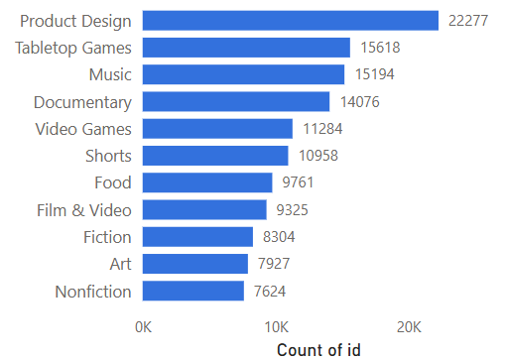
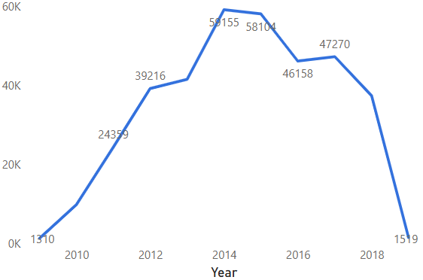
Objectives : KPIS
Category Breakdown :
Top Categories Product Design, Tabletop Games, Music, and Documentary lead the platform, driven by high creativity and strong community interest.
Mid-Tier Categories Categories like Video Games, Food, Film, Art, and Apparel show steady participation with moderate project volumes.
Lower-Tier Categories Tech, Publishing, Business, and other niche areas contribute fewer projects, reflecting limited creator activity.
Year-Based Outcome
Highest (2014 – 59K projects) 2014 marks the peak year with the largest surge in project launches.
Mid Range (2012–2017 – 39K to 58K projects) These years show consistent growth and sustained platform engagement.
Lowest (2009 – 1K, 2019 – 4K projects) Early launch and recent decline reflect low activity and reduced project creation.

Slide 6
Process Workflow
Data Cleaning Efficiently cleaned the dataset by removing duplicates and standardizing outcomes using Power Query.
Database Management & SQL Handled large-scale data in MySQL and wrote advanced queries to extract meaningful performance insights.
Dashboard Design Created interactive dashboards in Excel, Tableau, and Power BI using the right charts for trends and KPIs.
Project Management Skills Managed the full analytics lifecycle from raw data to insights, supported by strong documentation and storytelling.

Slide 7
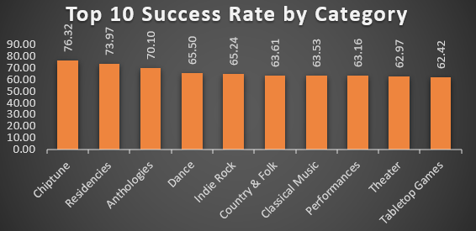
Success Rate by Goal Range :
Goals Under $1K: ~60% Success Rate
Goals $1K - $10K: Moderate Success Rate
Goals $10K - $100K: Significant Drop
Goals Over $500K: Success Rate Drops Below 10%
Analysis

Slide 8
Recommendations and Insights
Recommendations
1. Set Realistic Funding Goals
Campaigns with modest funding targets demonstrate significantly higher success rates, making achievable goals a critical factor for funding.
2. Prioritize High-Performing Categories
Focusing on categories with historically strong outcomes increases the probability of a successful campaign.
3. Preparation Outweighs Timing
Strategic planning and audience engagement have a greater impact on success than the specific launch date.
1. Platform Peak in 2014
Project activity reached its highest level in 2014 and has since declined, indicating a more mature and competitive environment.
2. U.S. Leads, With Global Growth Potential
The United States accounts for the majority of campaigns, highlighting substantial opportunity for expansion in other regions.
3. Majority of Projects Do Not Succeed
With failure rates exceeding 50%, effective planning and targeted execution are essential for favorable outcomes.
4. Success Is Driven by Strategy
Campaign performance is strongly influenced by goal setting, category selection, and audience targeting rather than chance.
Key Insights

Slide 9
Challenges & Learning
Large Data Volume The dataset was too big for manual handling in Excel, requiring scalable methods to process 365K+ records across 25 attributes.
Data Loading into MySQL Importing the data caused errors due to inconsistent columns, currency symbols in numeric fields, and mixed date formats, requiring careful correction.
Set Realistic Funding Goals A key insight was that smaller funding targets (under $1K) greatly improve success rates, making achievable goals more effective than ambitious ones.
Different Tool Requirements Each tool had unique data formatting needs, so the dataset had to be reorganized multiple times to work properly across Excel, Tableau, Power BI, and MySQL.
Time-Intensive Cleaning Standardizing dates, amounts, and backer data consumed significant time, reinforcing that thorough preprocessing is essential before analysis or visualization.

Slide 10
Conclusion: Actionable Strategies for Launch
The insights reveal a well-established yet highly competitive crowdfunding landscape, marked by strong participation and major financial movement, even as recent project volumes have declined.
Overall Platform Health The platform shows high activity and strong capital flow, proving its ability to fund large volumes of creative projects.
Community Size Nearly 40 million backers highlight a broad and engaged global supporter base.
Success Rate A 38.35% success rate indicates that a meaningful share of projects can get funded with the right approach.
Project Duration Successful campaigns typically finish in about 80 days, reflecting efficient funding cycles.
Top Categories Product Design and Tabletop Games perform best, showing concentrated creator and backer interest.
Goal Strategy Smaller funding targets under $1K deliver the highest success rates, making modest goals the most effective.
Market Dominance The United States leads with the largest number of campaigns, setting the tone for platform activity.
Great Britain’s Position Great Britain ranks second, contributing significantly but still far below U.S. volume.

Slide 11
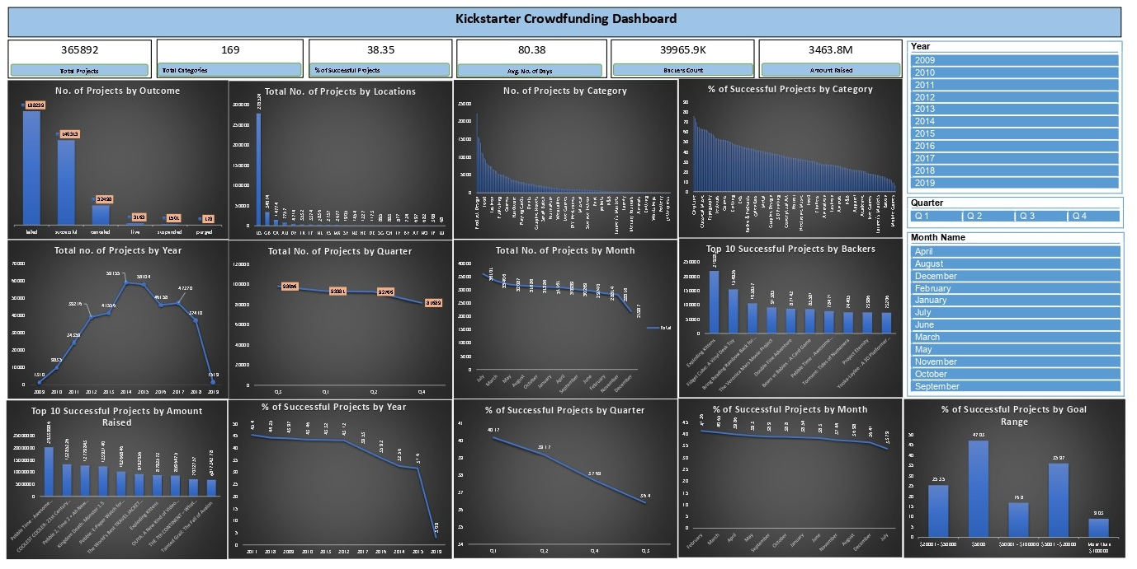
Excel

Slide 12
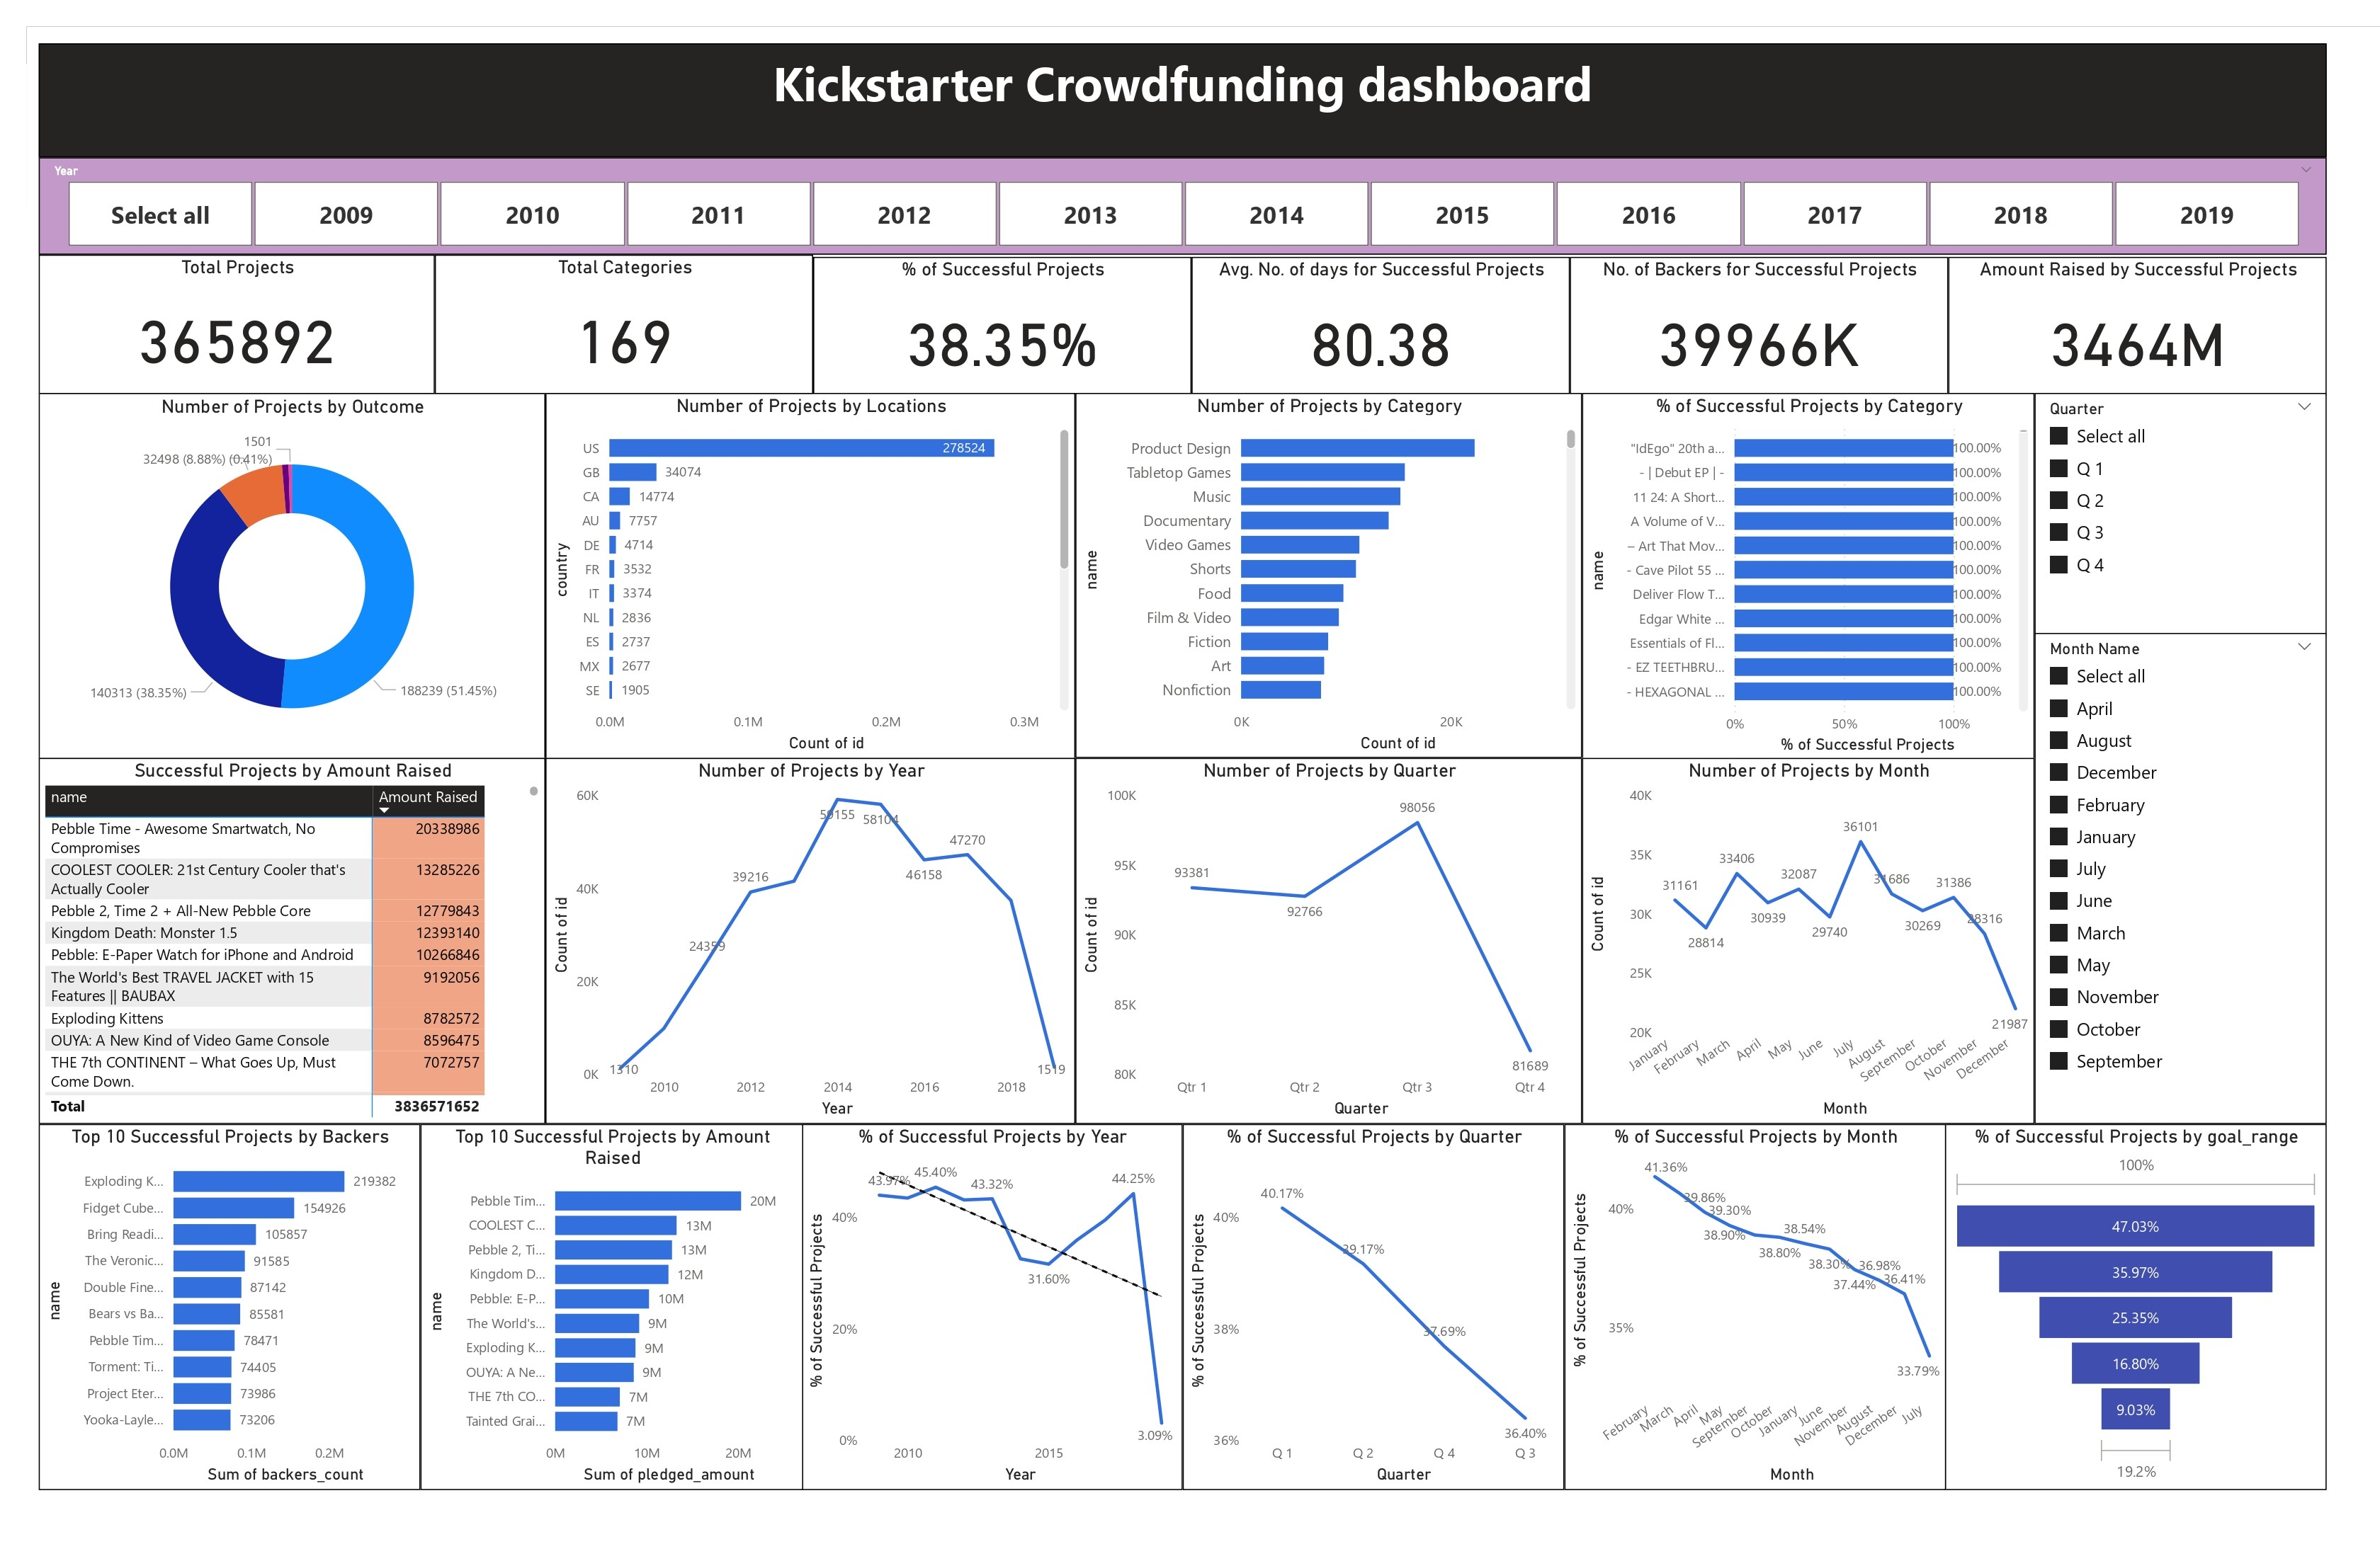
Power BI

Slide 13
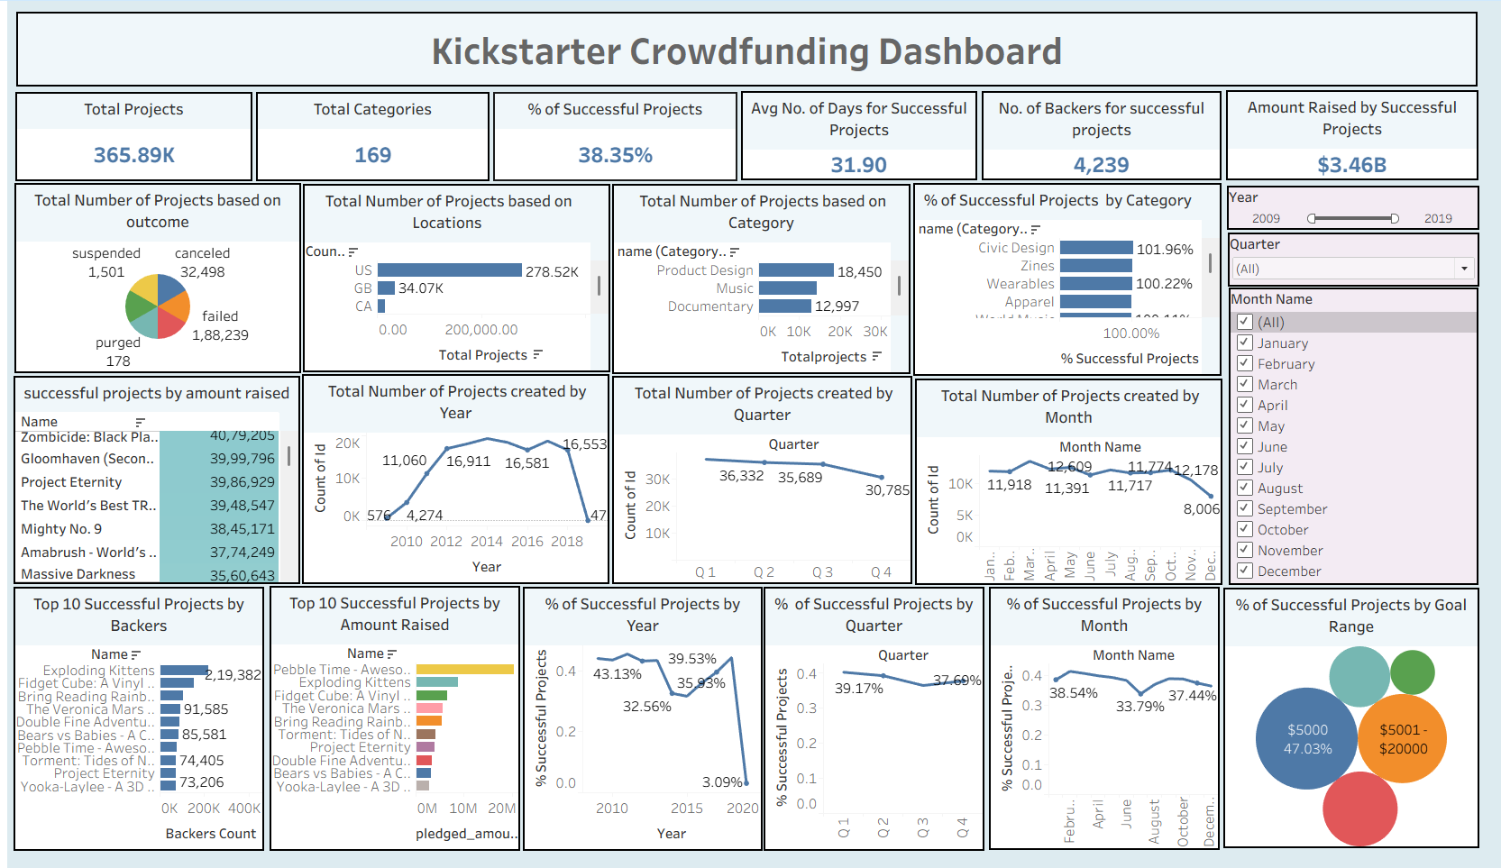
Tableau

Slide 14
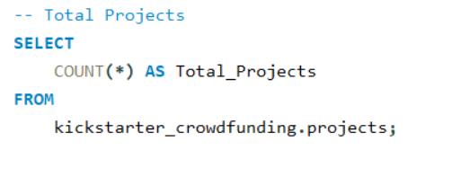
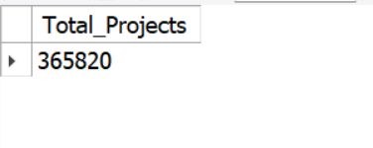
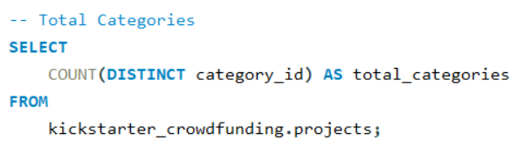
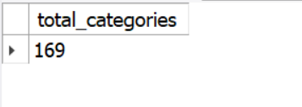
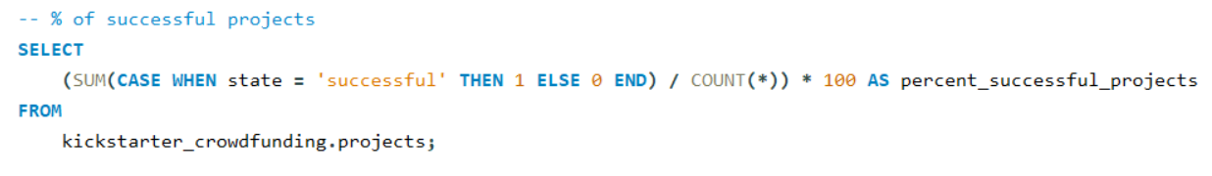
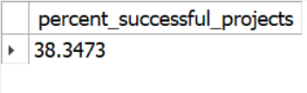

Slide 15
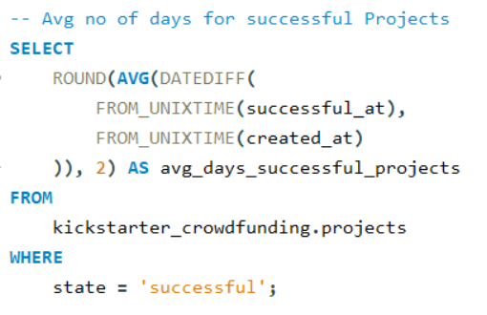

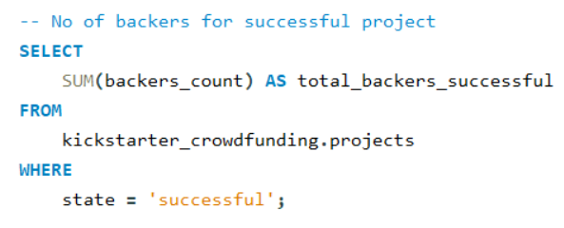

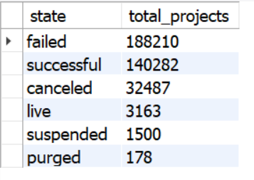
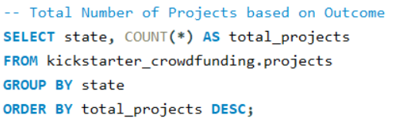

Slide 16
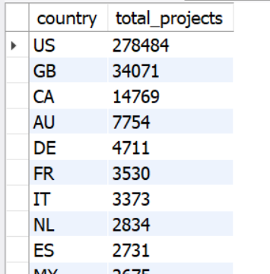
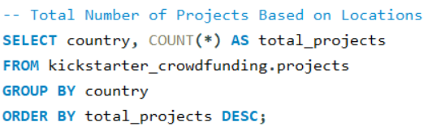
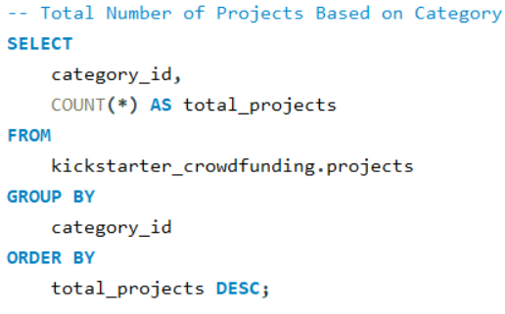
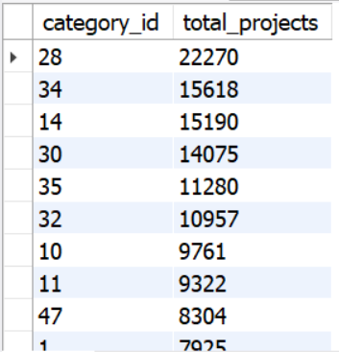

Slide 17
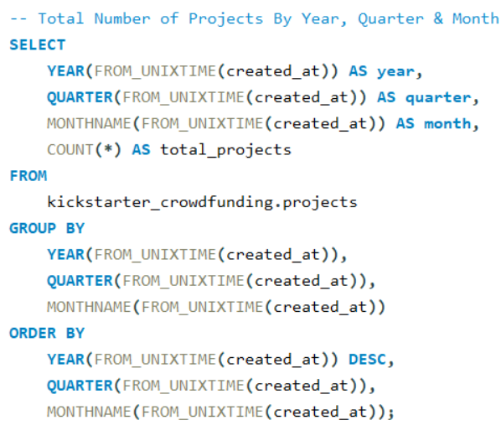
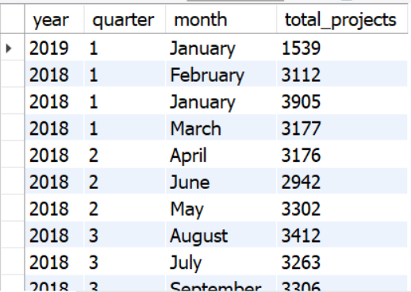
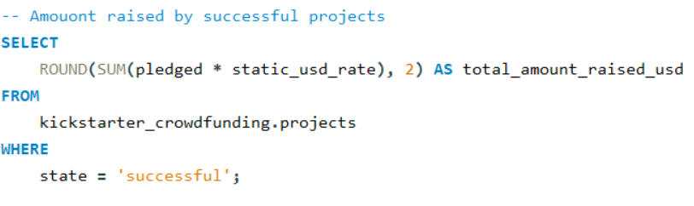


Slide 18
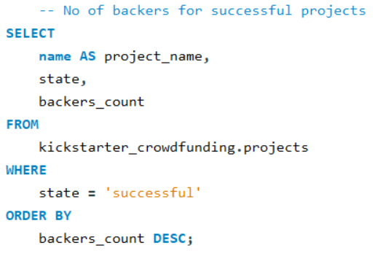
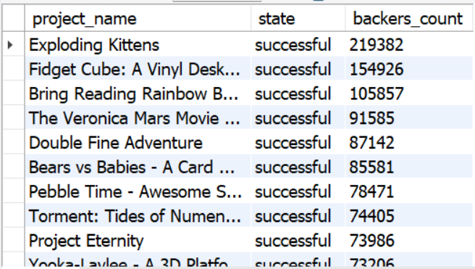
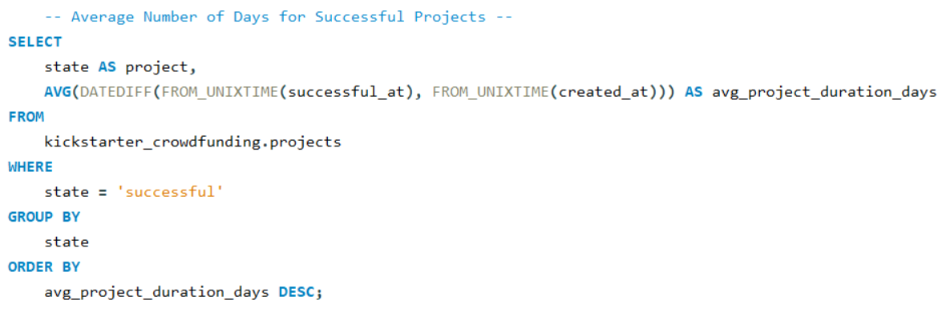


Slide 19
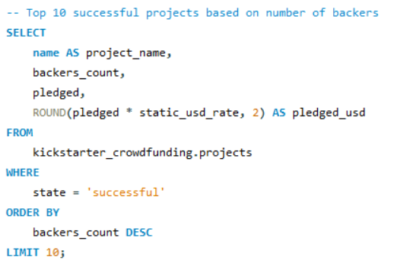
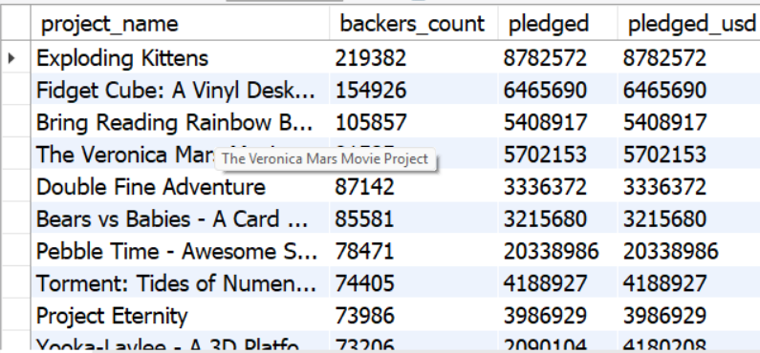
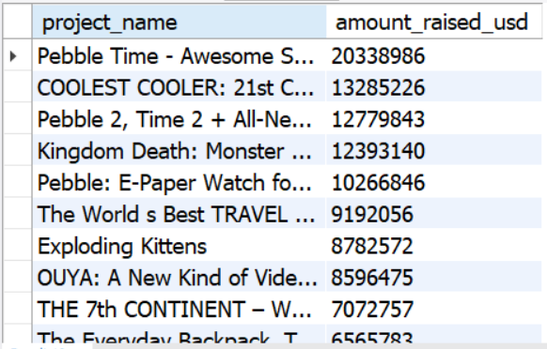
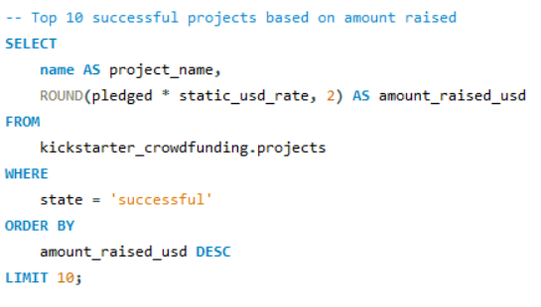
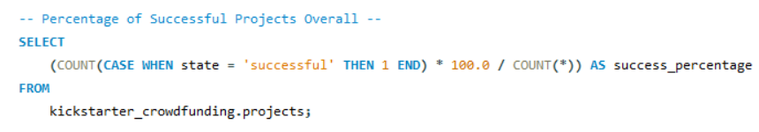


Slide 20
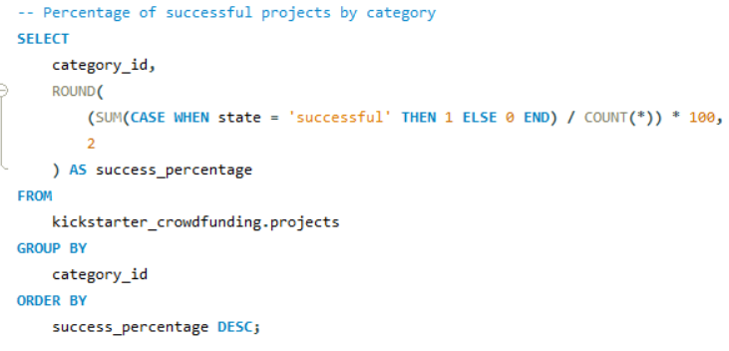
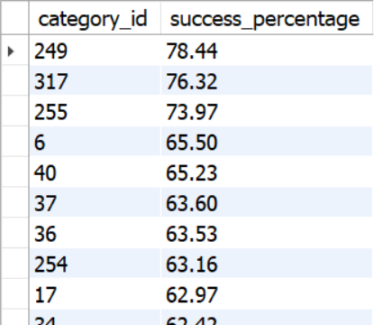
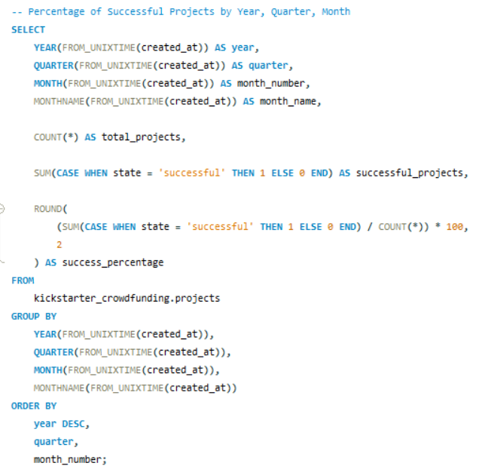
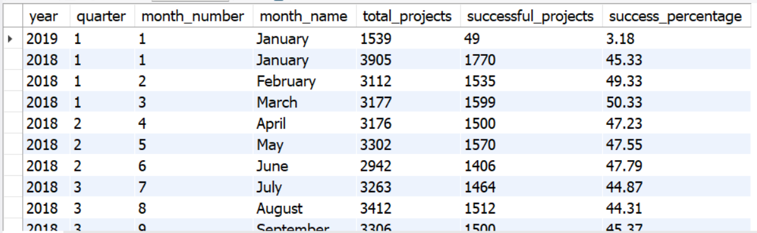

Slide 21
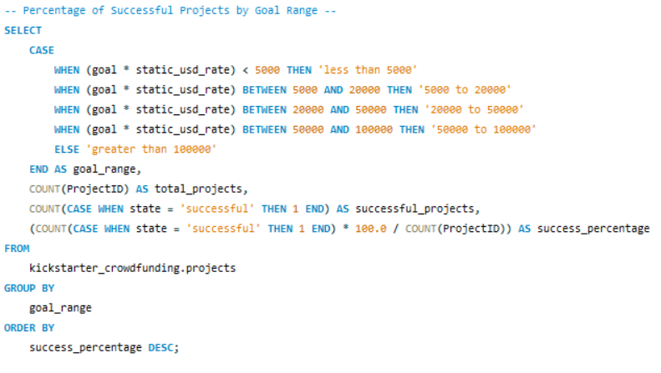
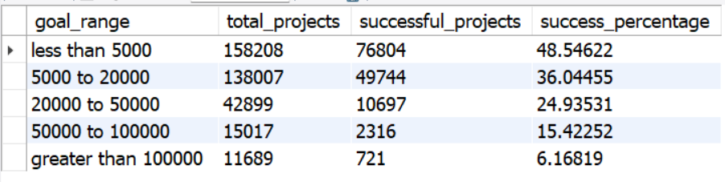

Slide 22
Thank You

